Slide 1
CS 135 Scalable SW Architecture
Spring 2018
Prof. Mariam Salloum

Slide 2
Outline
Defining Distributed Systems (DS)
Characteristics of DS
Examples of DS
Challenges of DS
World Wide Web as a DS
History
Protocols
HTTP
Architecture

Slide 3
What are Distributed Systems
Early computing was performed on a single processor … usually refered to as Centralized Computing.
A Distributed System is a collection of independent computers, interconnected via a network, which are able to coordinate on a task and appear to users as a single coherent system.

Slide 4
Networks vs. Distributed Systems
Networks: A media for interconnecting local and wide area computers and exchange messages based on protocols. Network entities are visible and they are explicitly addressed (IP address).
Distributed System: existence of multiple autonomous computers is transparent
They share many challenges (e.g., openness, reliability) in common, but at different levels.
Networks focuses on packets, routing, etc., whereas distributed systems focus on applications.
Every distributed system relies on services provided by a computer network.
Distributed Systems
Computer Networks
Notes:
These protocols are generally ‘well defined’, such as TCP/UDP over IP, IPX, NETBIOS.
In DS, much of the complexity is handled by the network layer, however we cannot assume everything is 100% reliable.
In DS, we operate at a higher level, but we must be mindful of the failures that can and will occur on Computer Networks.

Slide 5
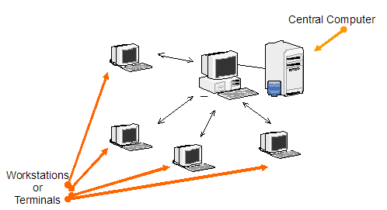
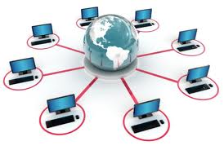
Reasons for Distributed Systems
Functional Separation:
Existence of computers with different capabilities and purposes
Inherent distribution:
Different information is created and maintained by different people / organizations
Power imbalance and load variation:
Distribute computational load among different computers.
Reliability:
Long term preservation and data backup (replication) at different locations.
Economies:
Sharing a printer by many users and reduce the cost of ownership.
Building a supercomputer out of a network of computers.
Notes:
There are many practical reasons to utilise DS:
Functional Separation: Beneficial to separate collection from processing
Inherent dist: The process/activity is naturally distributed
Power/ load: We are forced to use DS as one system cannot handle!
Reliability: Government reg. may force us to retain data for 10 years
Economies: Share resources, statistical multiplexing

Slide 6
Consequences of Distributed Systems
Parallel activities
Autonomous components executing concurrent tasks
Communication via message passing
No shared memory
Resource sharing
Printer, database, other services
No global state
No single process can have knowledge of the current global state of the system
No global clock
Only limited precision for processes to synchronize their clocks
Notes:
Consequences are problems that need solving when we choose DS:
Concurrency: Tasks happen independently, but periodically convenve to exchange status update or other information. We need to deal with it.
Heterogeneity: Different hardware, different software, different protocols
No global clock: We cannot assume correctness of timing given.
Ind. Failures: Many components working together (ie goog), any can fail

Slide 7
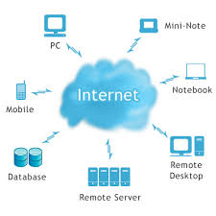
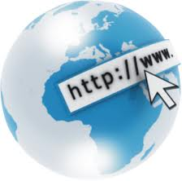
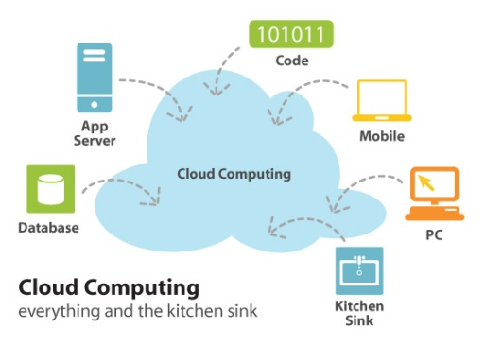
Examples of Distributed Systems
They (DS) are based on familiar and widely used computer networks:
Internet
Intranets, and
Wireless networks
Example DS:
Web (and many of its applications like Facebook)
Data Centers and Clouds
Wide area storage systems
Banking Systems
Notes:
Most of you should have used all of these DS.

Slide 8
A typical portion of the Internet
The Internet is a vast collection of computer networks of many different types and hosts various types of services.
Intranet
%
ISP
%
%
%
backbone
satellite link
desktop computer:
server:
network link:
Notes:
Programs run on computers, and they interact via message passing
The internet is a very large DS, consisting of many participants.
Governments, and large telcos operate the backbones that carry the bulk of the traffic
ISP’s provide connectivity between the backbones and smaller networks
Many services run, email, www, ftp, video/audio streaming etc.

Slide 9

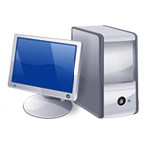





A typical Intranet
A portion of Internet that is separately administered & supports internal sharing of resources (file/storage systems and printers)
Desktop computers
Print and other servers
email server
Local area
Web server
network
email server
print
File server
other servers
the rest of
the Internet
router/firewall
Notes:
Intranet is a seperately administered DS, that has a boundary between intra and internet.
Intranet can be one small LAN or many interconnected private sites.
Firewall can be used to allow authorised users in & out but keep unwanted / malicious users from causing harm.
Some intranets (e.g. Defence, Hospitals) may choose to keep them entirely separate from the internet to ensure security.

Slide 10
The World Wide Web
Brief History
Internet Protocols
Client-Server Model
Domain Name Systems
Uniform Resource Locator (URL)
Hypertext Transfer Protocol (HTTP)
Web Servers

Slide 11
The World Wide Web
By far the best known distributed application is the World Wide Web (WWW).
Technically, the web is a distributed system of HTTP servers and clients, more commonly known as web servers and web browsers.
Prior to the emergence of the web, the user community of the Internet largely comprised of researchers and academics who used network services such as electronic mail and file transfer to exchange data.

Slide 12
ARPANET ... The beginnings of the Internet
The research network ARPANET was created in the 1960s.
It was funded and controlled by the United States government, and was used exclusively for academic and scientific purposes.
The early network started small with just a handful of connected campuses in 1969 and grew to a few hundred by the early 1980s.
It proposed : a packet-switched network and a network protocol.
Want to lean more? https://www.youtube.com/watch?v=nsdFNTeGqIg

Slide 13
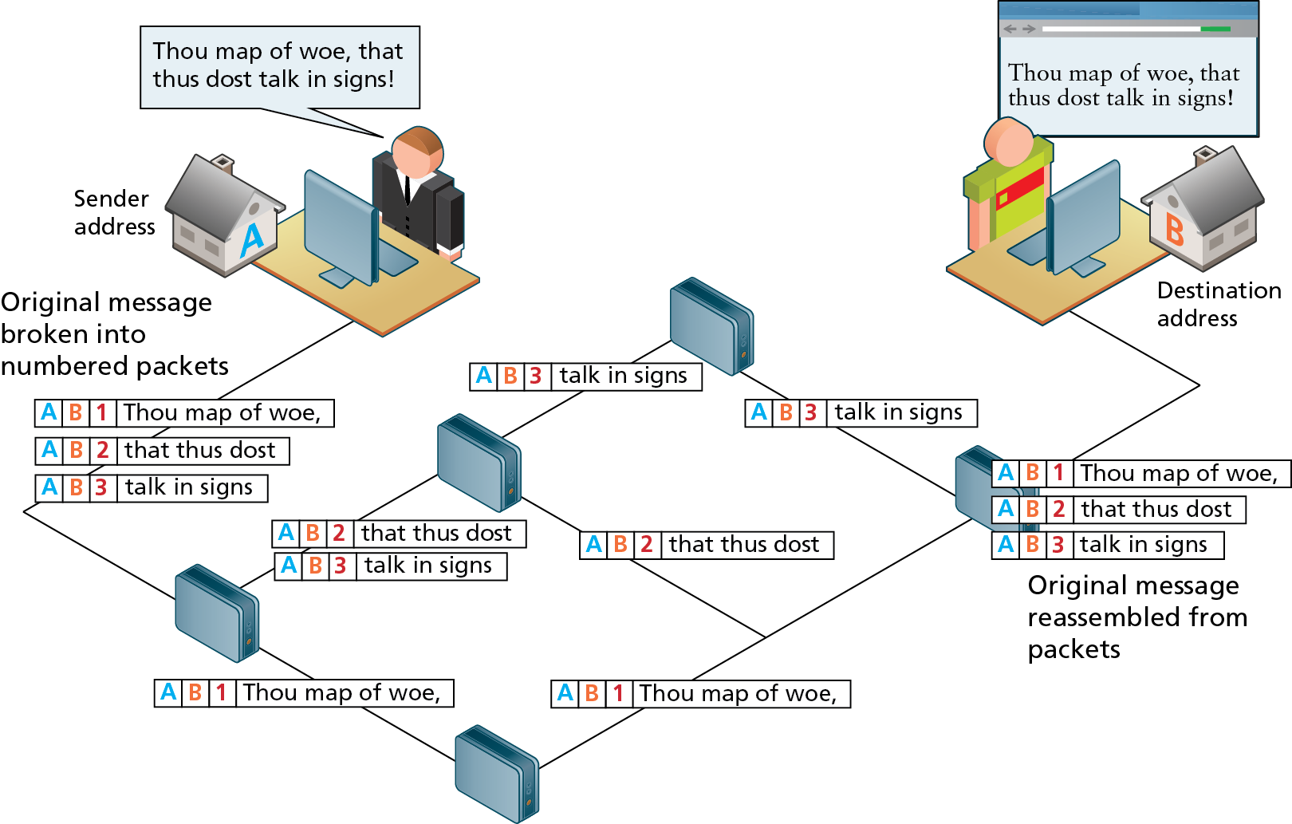
Packet Switching
ARPANET proposed and used a packet-switched network, which does not require a continuous connection.
Instead it splits the messages into smaller chunks called packets and routes them to the appropriate place based on the destination address.
Leonard Kleinrock at UCLA

Slide 14
TCP/IP
To promote the growth and unification of the disparate networks a suite of protocols was invented to unify the networks together.
By 1981, new networks built in the US began to adopt the TCP/IP (Transmission Control Protocol / Internet Protocol) communication model, while older networks were transitioned over to it.

Slide 15
The World Wide Web
The World Wide Web originated with Tim Berners-Lee in late 1990 for CERN, the European Particle Physics Laboratory in Geneva, Switzerland.
A proposal for a "universal hypertext system" was submitted in November 1990 by Tim Berners-Lee and Robert Cailliau for a "universal hypertext system."

Slide 16
Core Features of the Web
Shortly after that initial proposal Berners-Lee developed the main features of the web:
A URL to uniquely identify a resource on the WWW.
The HTTP protocol to describe how requests and responses operate.
A software program (later called web server software) that can respond to HTTP requests.
HTML to publish documents.
A program (later called a browser) to make HTTP requests from URLs and that can display the HTML it receives.

Slide 17
W3C
Also in late 1994, Berners-Lee helped found the World Wide Web Consortium (W3C), which would soon become the international standards organization that would oversee the growth of the web.
This growth was very much facilitated by the decision of CERN to not patent the work and ideas done by its employee and instead left the web protocols and code-base royalty free.
W3C : https://www.w3.org/

Slide 18
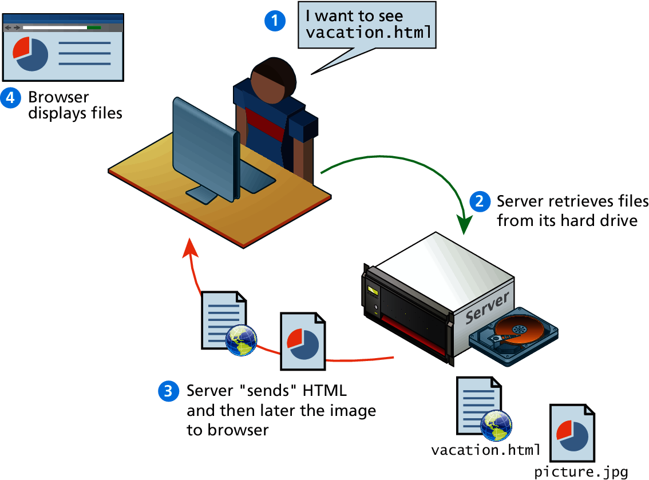
Static Web Sites
In the early days of the web, a webmaster would only periodically update the pages.
This type of web site is commonly referred to as a static web site.

Slide 19
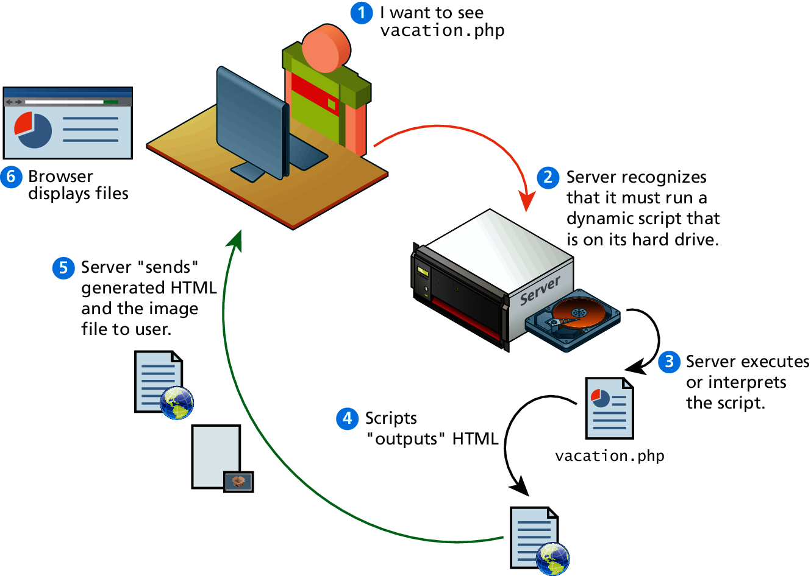
Dynamic Web Sites
Within a few years of the invention of the web, sites began to get more complicated as more and more sites began to use programs running on web servers to generate content dynamically.
A dynamic web site is a page content that is created at run-time by a program created by a programmer; this page content can vary for user to user.

Slide 20
What’s a Protocol?
A protocol is a set of rules that are used when computers communicate.
The TCP/IP Internet protocols were originally abstracted as a four-layer stack.
Later abstractions subdivide it further into five or seven layers.
Since we are focused on the top layer anyhow, we will use the earliest and simplest four-layer network model.

Slide 21
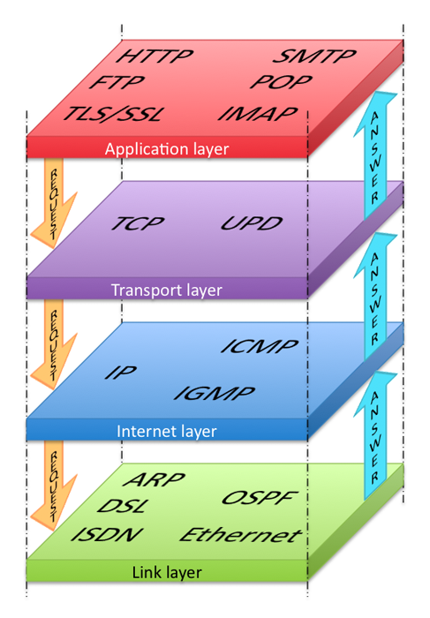
Layered Architecture
Higher protocols that allow applications to interact with the transport layer
Ensures transmissions arrive in order and without error
Establishes connection, routing, and addressing
Responsible for physical transmission of raw bits

Slide 22
Link Layer
The link layer is the lowest layer, responsible for both the physical transmission across media (wires, wireless) and establishing logical links.
It handles issues like packet creation, transmission, reception and error detection, collisions, line sharing and more.

Slide 23
Internet Layer
The internet layer (sometimes also called the IP Layer) routes packets between communication partners across networks.

Slide 24
Internet Protocol (IP)
The Internet uses the Internet Protocol (IP) addresses to identify destinations on the Internet.
Every device connected to the Internet has an IP address, which is a numeric code that is meant to uniquely identify it.
Your IP address will generally be assigned to you by your Internet Service Provider (ISP).
In organizations, large and small, purchasing extra IP addresses from the ISP is not cost effective.
In a local network, computers can share a single IP address between them.

Slide 25
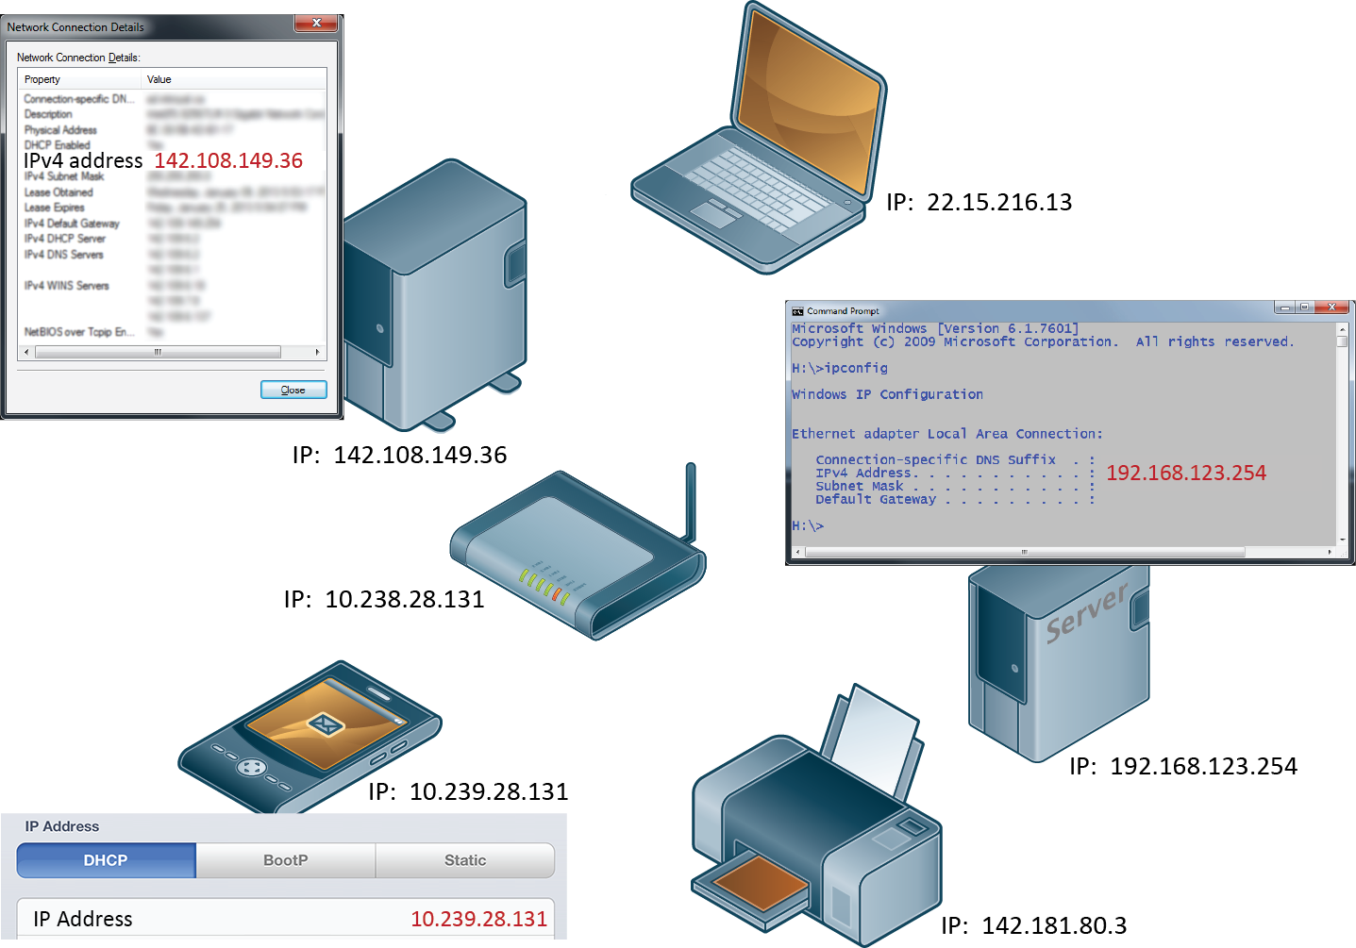
IP addresses and the Internet

Slide 26
IP Addresses
IPv4 addresses are the IP addresses from the original TCP/IP protocol.
In IPv4, 12 numbers are used (implemented as four 8-bit integers), written with a dot between each integer.
Since an unsigned 8-bit integer's maximum value is 255, four integers together can encode approximately 4.2 billion unique IP addresses.

Slide 27
IP Addresses
To future proof the Internet against the 4.2 billion limit, a new version of the IP protocol was created, IPv6.
This newer version uses eight 16-bit integers for 2¹²⁸ unique addresses, over a billion billion times the number in IPv4.
These 16-bit integers are normally written in hexadecimal, due to their longer length.

Slide 29
Transport Layer
The transport layer ensures transmissions arrive, in order, and without error.
This is accomplished through a few mechanisms.
First, the data is broken into packets formatting according to the Transmission Control Protocol (TCP).
Secondly, each packet is acknowledged back to the sender so in the event of a lost packet, the transmitter will realize a packet has been lost since no ACK arrived for that packet.
That packet is retransmitted, and although out of order, is reordered at the destination.

Slide 30
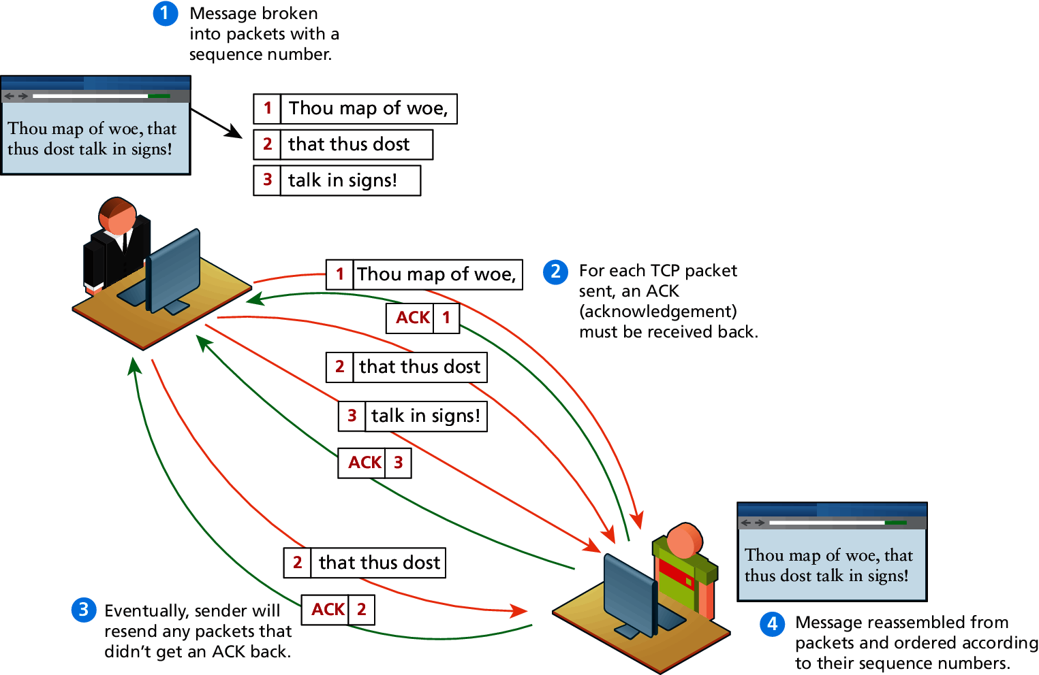
TCP Packets

Slide 31
Application Layer
With the application layer, we are the level of protocols familiar to most web developers.
Application layer protocols implement process-to-process communication and are at a higher level of abstraction in comparison to the low-level packet and IP addresses protocols in the layers below it.
Examples: HTPP, SSH, FTP, DNS, POP, SMTP.

Slide 32
Client-Server Model
The web is sometimes referred to as a client-server model of communications.
In the client-server model, there are two types of actors: clients and servers.
The server is a computer agent that is normally active 24 hours a day, 7 days a week (or simply 24/7), listening for queries from any client who make a request.
A client is a computer agent that makes requests and receives responses from the server, in the form of response codes, images, text files, and other data.

Slide 33
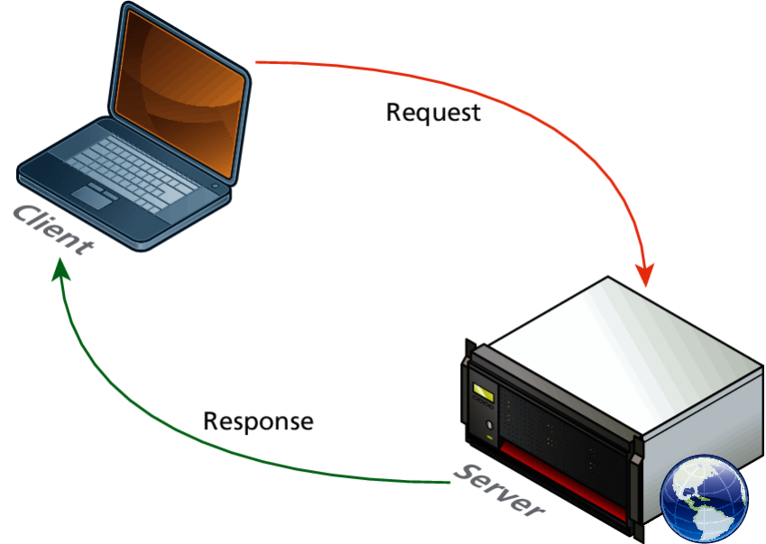
Request-Response Loop
Within the client-server model, the request-response loop is the most basic mechanism on the server for receiving requests and transmitting data in response.
The client initiates a request to a server and gets a response that could include some resource like an HTML file, an image or some other data.

Slide 34
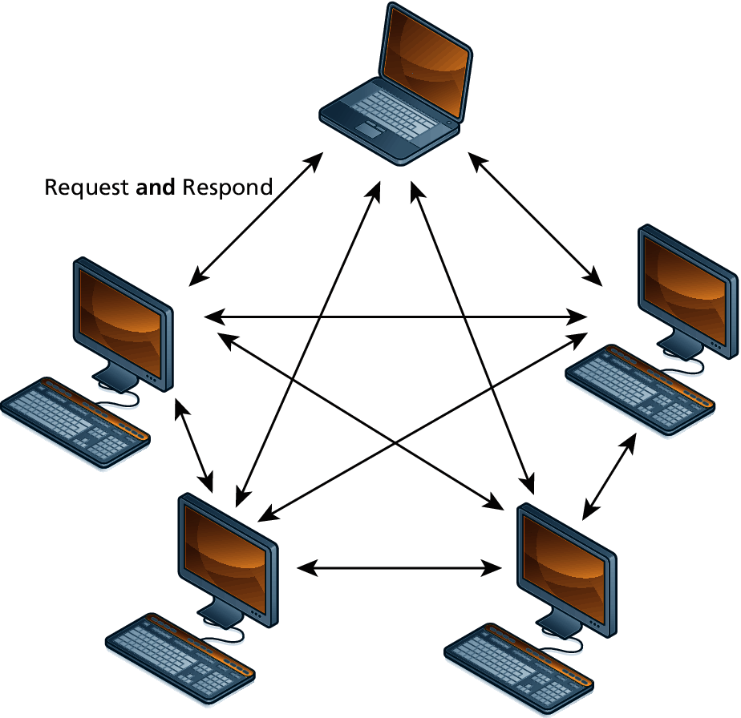
The Peer-to-Peer Alternative
In the peer-to-peer model where each computer is functionally identical, each node is able to send and receive directly with one another.
In such a model each peer acts as both a client and server able to upload and download information.
Used for computing clusters

Slide 35
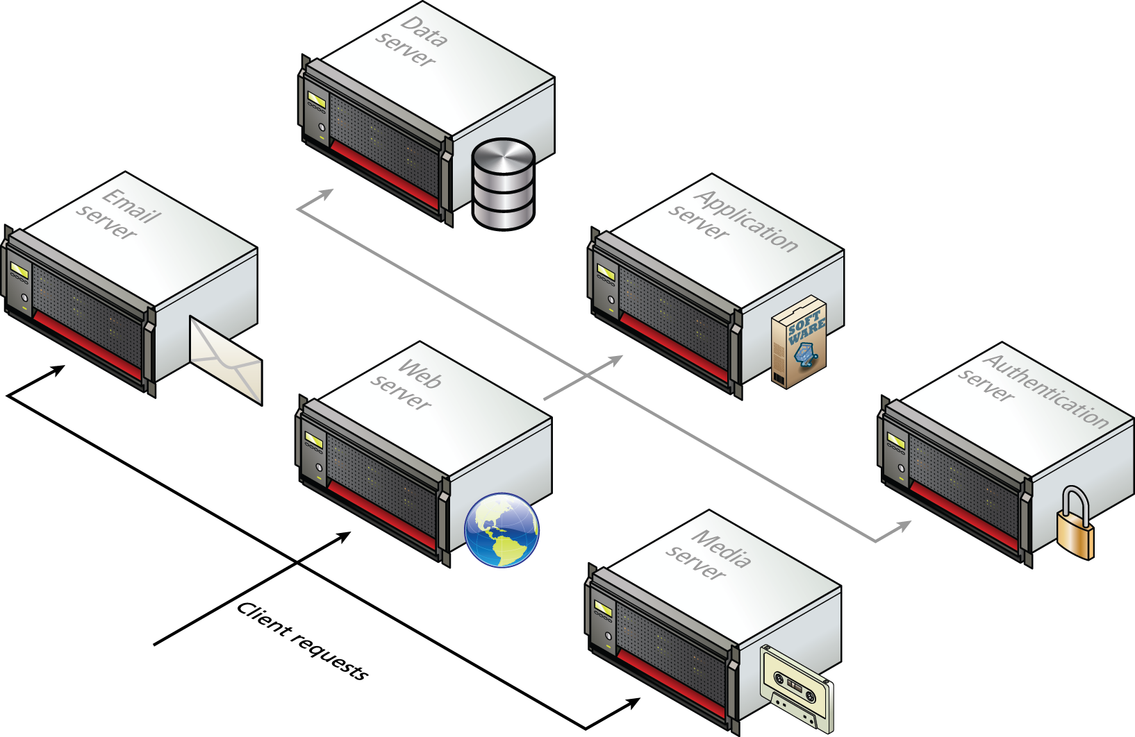
Server Types
Earlier, the server was shown as a single machine, which is fine from a conceptual standpoint.
Clients make requests for resources from a URL; to the client, the server is a single machine.
However, most real-world web sites are typically not served from a single server machine, but by many servers.
It is common to split the functionality of a web site between several different types of server.

Slide 36
Real-World Server Installations
Not only are there different types of servers, there is often replication of each of the different server types.
A busy site can receive thousands or even tens of thousands of requests a second; globally popular sites such as Facebook receive millions of requests a second.

Slide 37
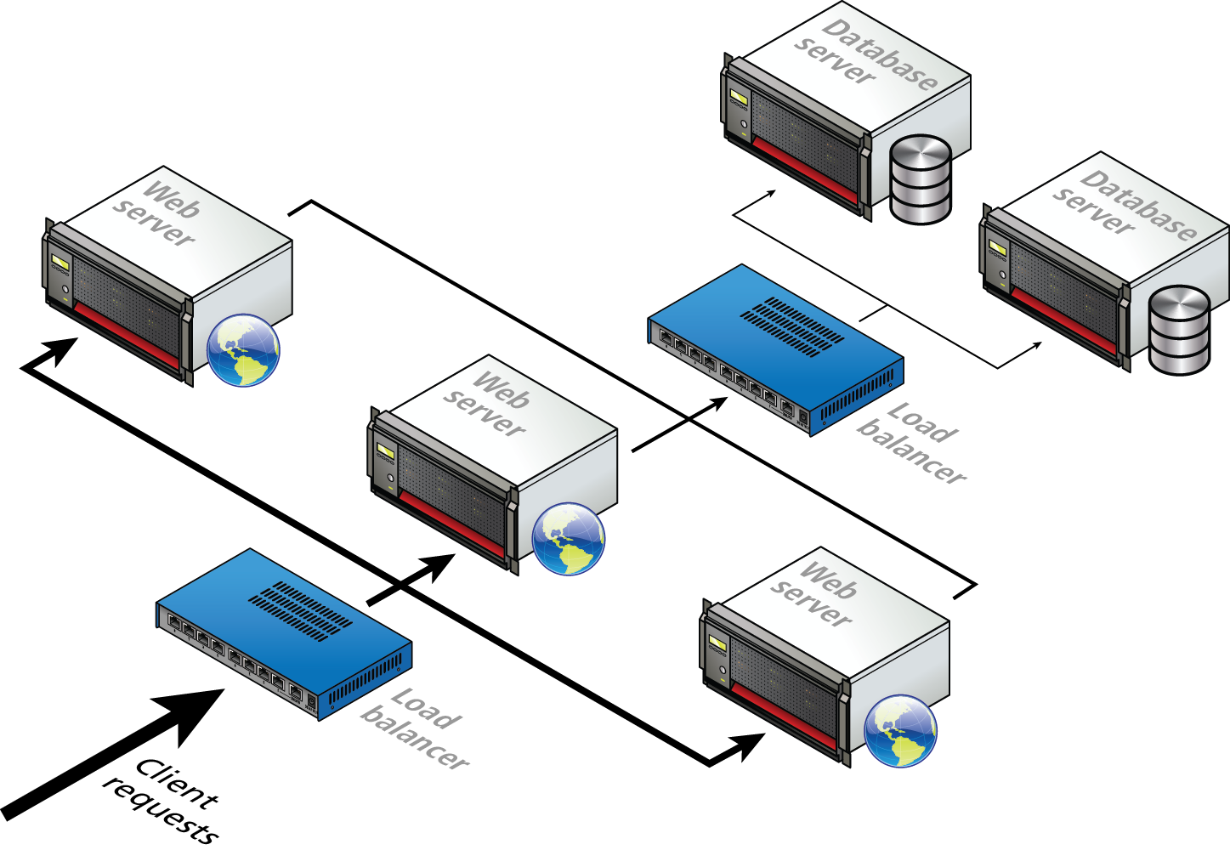
Server Farm

Slide 38
Server Farms
Server farms are used to distribute incoming requests between clusters of machines so that any given web or data server is not excessively overloaded.
Special routers called load balancers distribute incoming requests to available machines.
Even if a site can handle its load via a single server, it is not uncommon to still use a server farm because it provides failover redundancy.
That is, if the hardware fails in a single server, one of the replicated servers in the farm will maintain the site’s availability.

Slide 39
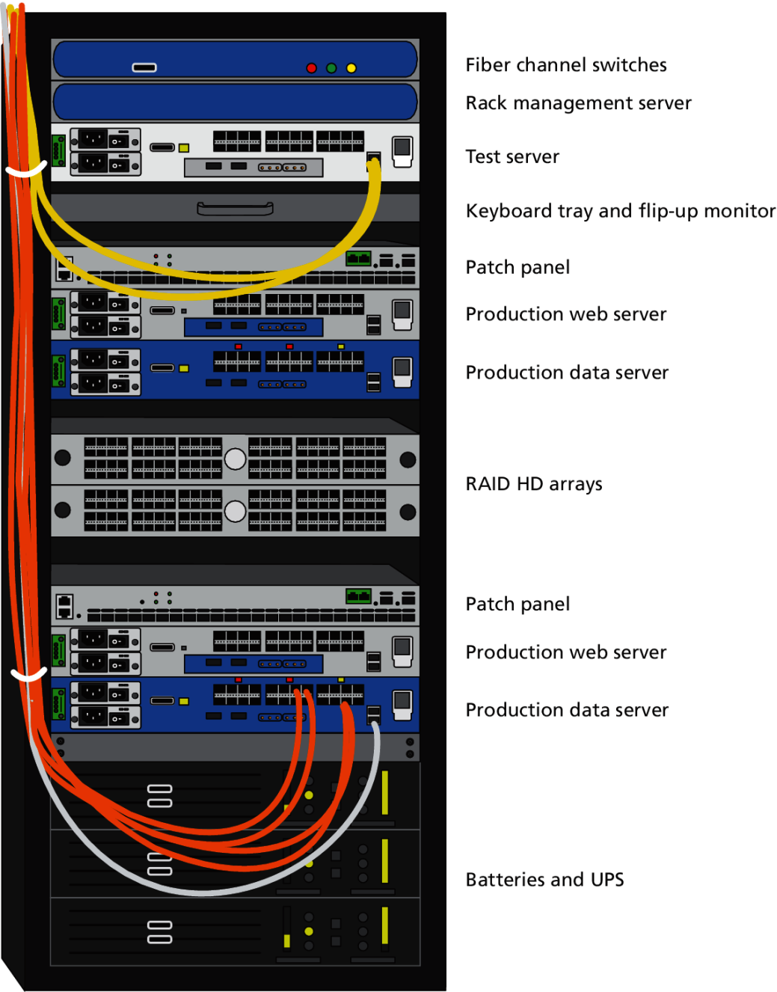
Server Rack
Server farms will have its servers and hard drives stacked on top of each other in server racks.
A typical server farm will consist of many server racks, each containing many servers.
Server farms are typically housed in special facilities called data centers.

Slide 40
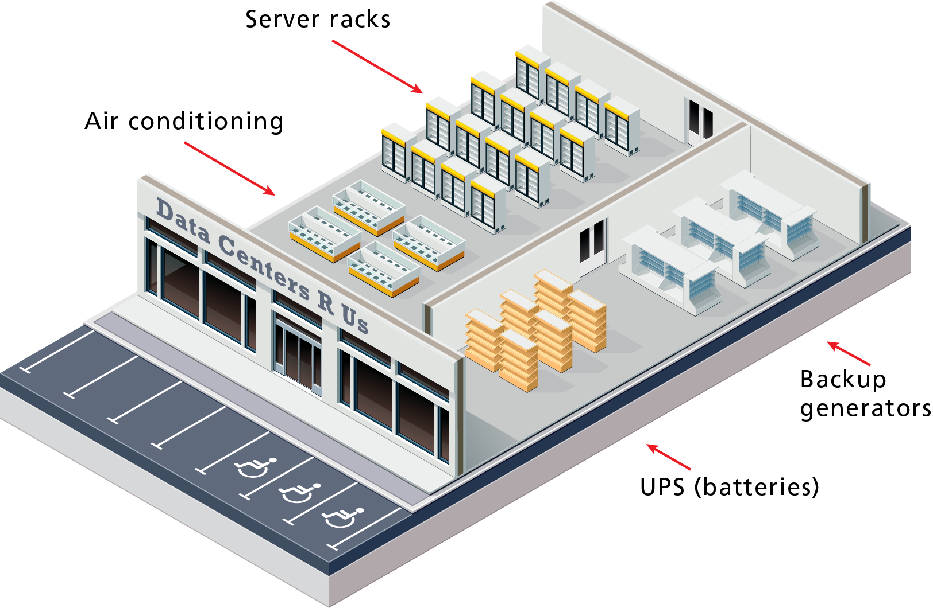
Hypothetical Data Center

Slide 41
Data Centers
To prevent the potential for site down times, most large web sites will exist in mirrored data centers in different parts of the country, or even world.
As a consequence, the costs for multiple redundant data centers are quite high, and only larger web companies can afford to create and manage their own.
Most web companies will instead lease space from a third-party data center.

Slide 42
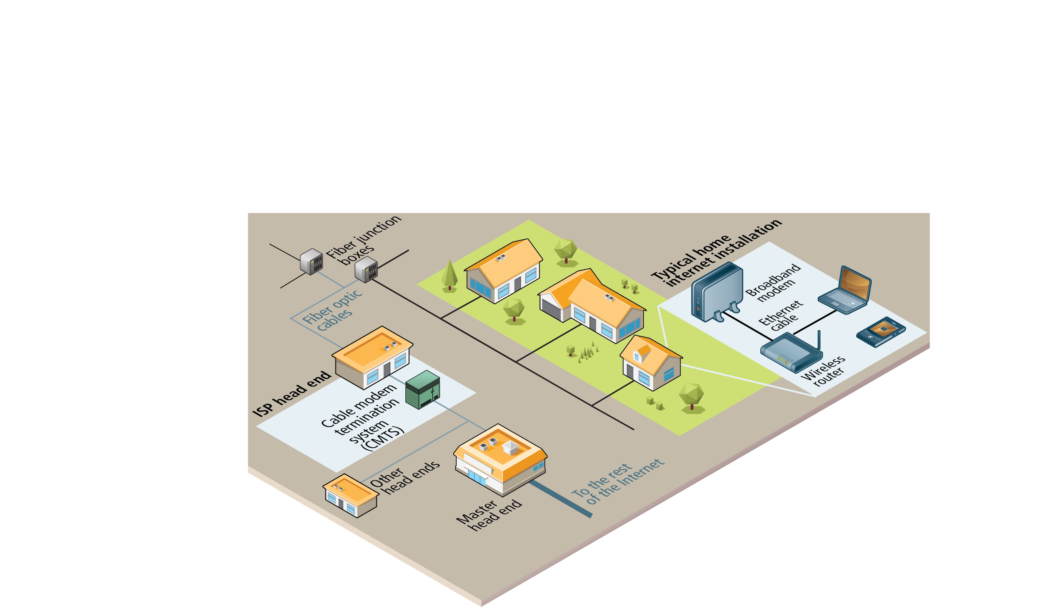
Is the Internet a Cloud?
The global network of networks is implemented via
millions of kilometers of copper wires and fiber optic cables, as well as via
hundreds of thousands of server computers
and probably an equal number of routers, switches, and other networked devices,
along with many thousands of air conditioning units and specially-constructed server rooms and buildings.
Notes:
Fun fact: Fiber optic cable (or simply optical fiber) is a glass-based wire that transmits light and has significantly greater bandwidth and speed in comparison to metal wires.
In some cities (or large buildings), you may have fiber optic cable going directly into individual buildings; in such a case the fiber junction box will reside in the building

Slide 43
In the House
The broadband modem is a bridge between the network hardware outside the house (typically controlled by a phone or cable company) and the network hardware inside the house.
These devices are often supplied by the ISP.
The wireless router is a hardware device that forwards data packets from one network to another network.

Slide 44
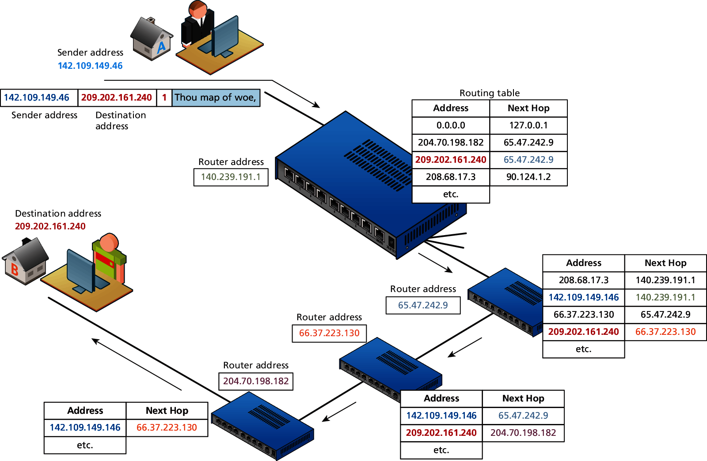
Routers and Routing Tables

Slide 45
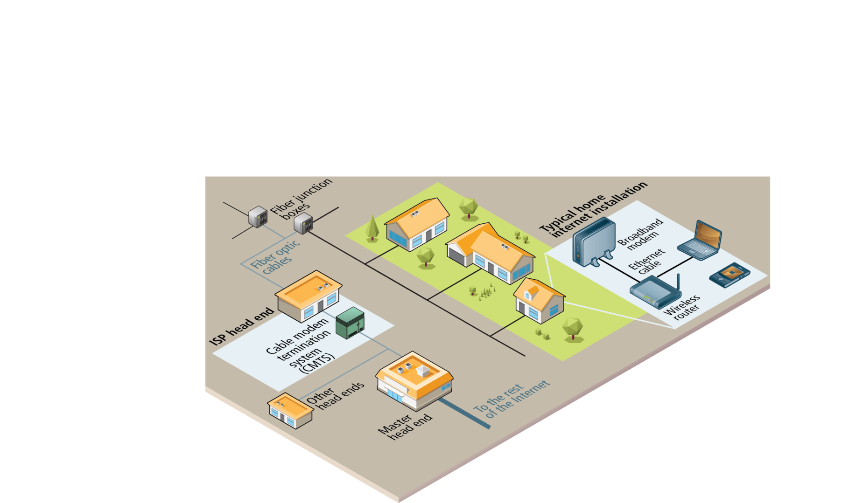
Out of the House
Once we leave the confines of our own homes, the hardware of the Internet becomes much murkier.
In the illustration, the various neighborhood broadband cables (which are typically using copper, aluminum, or other metals) are aggregated and connected to fiber optic cable via fiber connection boxes.

Slide 46
To the Provider
These fiber optic cables eventually make their way to an ISP’s head-end, which is a facility that may contain a cable modem termination system (CMTS) or a digital subscriber line access multiplexer (DSLAM) in a DSL-based system.

Slide 47
From the Local Provider to the Ocean
Eventually your ISP has to pass on your requests for Internet packets to other networks.
This intermediate step typically involves one or more regional network hubs.
Your ISP may have a large national network with optical fiber connecting most of the main cities in the country.
Some countries have multiple national or regional networks, each with their own optical network.

Slide 48
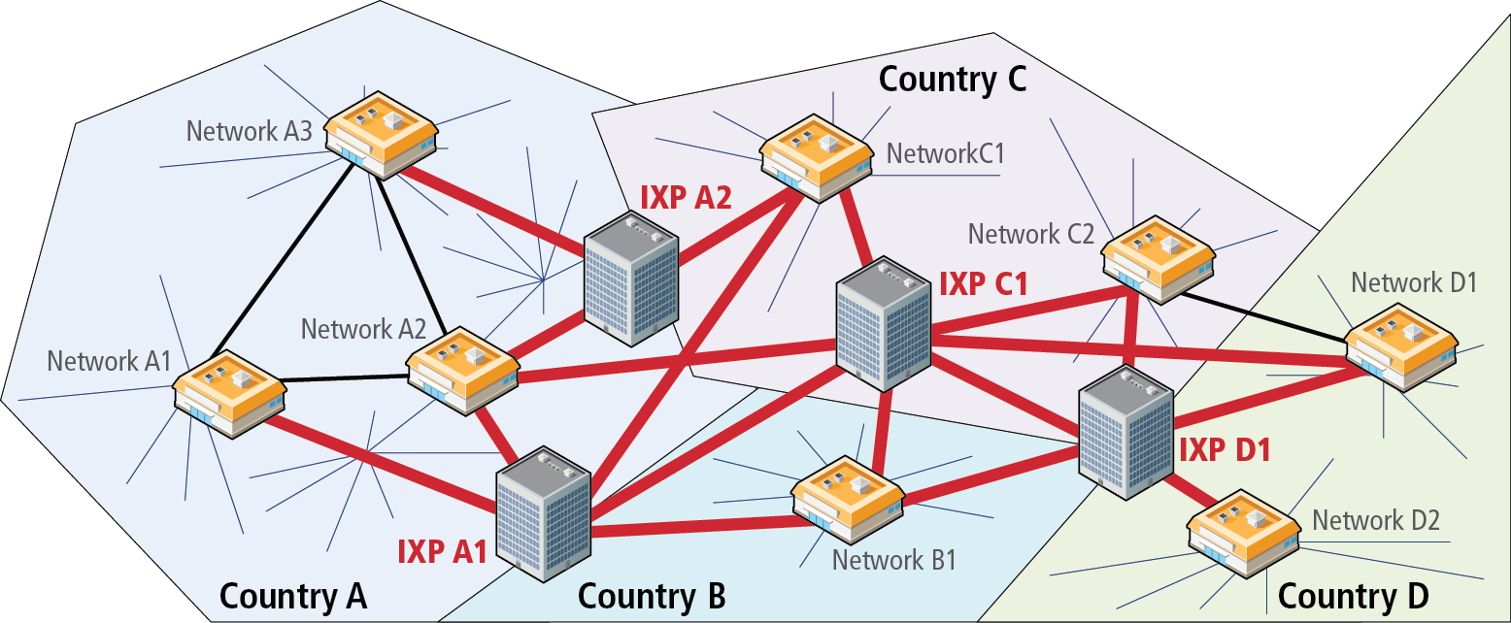
Internet Exchange Points
This type of network configuration began to change in the 2000s, as more and more networks began to interconnect with each other using an Internet Exchange Point (IX or IXP).
These IXPs allow different ISPs to peer with one another (that is, interconnect) in a shared facility, thereby improving performance for each partner in the peer relationship.

Slide 49
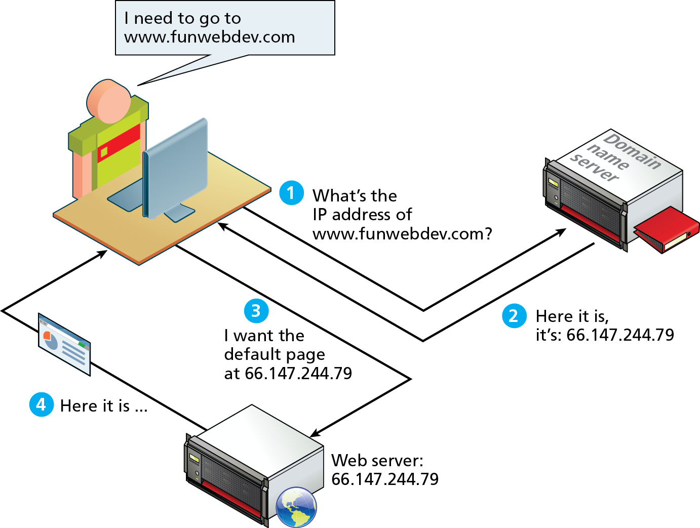
Domain Name System
As elegant as IP addresses may be, human beings do not enjoy having to recall long strings of numbers.
Instead of IP addresses, we use the Domain Name System (DNS)

Slide 50
Domain Levels

Slide 51
Types of TLDs
Generic top-level domains (gTLD)
Country code top-level domain (ccTLD)

Slide 52
Name Registration
How are domain names assigned?
Special organizations or companies called domain name registrars manage the registration of domain names.
These domain name registrars are given permission to do so by the appropriate generic top-level domain (gTLD) registry and/or a country code top-level domain (ccTLD) registry.

Slide 53
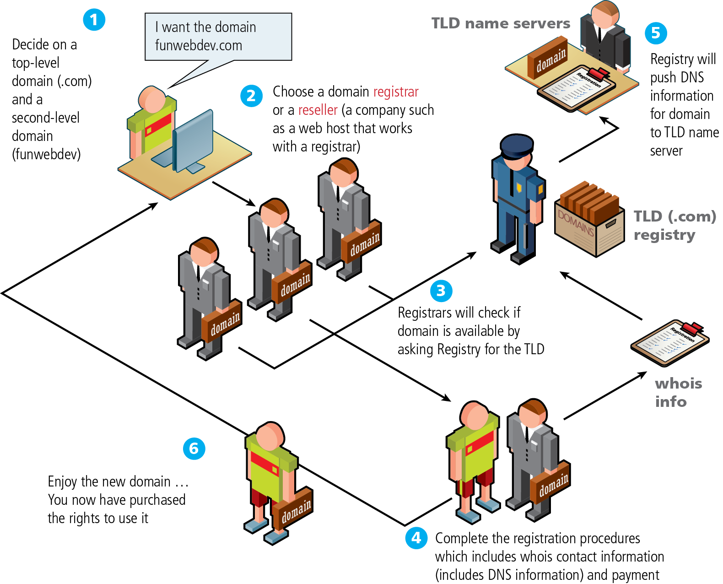
Domain name registration process

Slide 54
DNS Address Resolution
While domain names are certainly an easier way for users to reference a web site, eventually, your browser needs to know the IP address of the web site in order to request any resources from it.
The Domain Name System provides a mechanism for software to discover this numeric IP address.
This process is referred to here as address resolution.

Slide 55
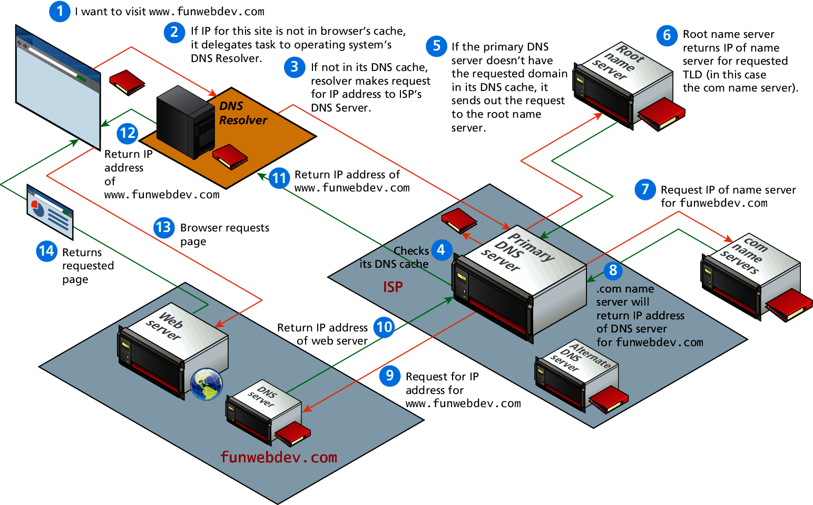
Domain name address resolution process

Slide 56
URL Components
In order to allow clients to request particular resources from the server, a naming mechanism is required so that the client knows how to ask the server for the file.
For the web that naming mechanism is the Uniform Resource Locator (URL).

Slide 57
Query String
Query strings will be covered in depth when we learn more about HTML forms and server-side programming.
They are the way of passing information such as user form input from the client to the server.
In URL's they are encoded as key-value pairs delimited by “&” symbols and preceded by the “?” symbol.

Slide 58
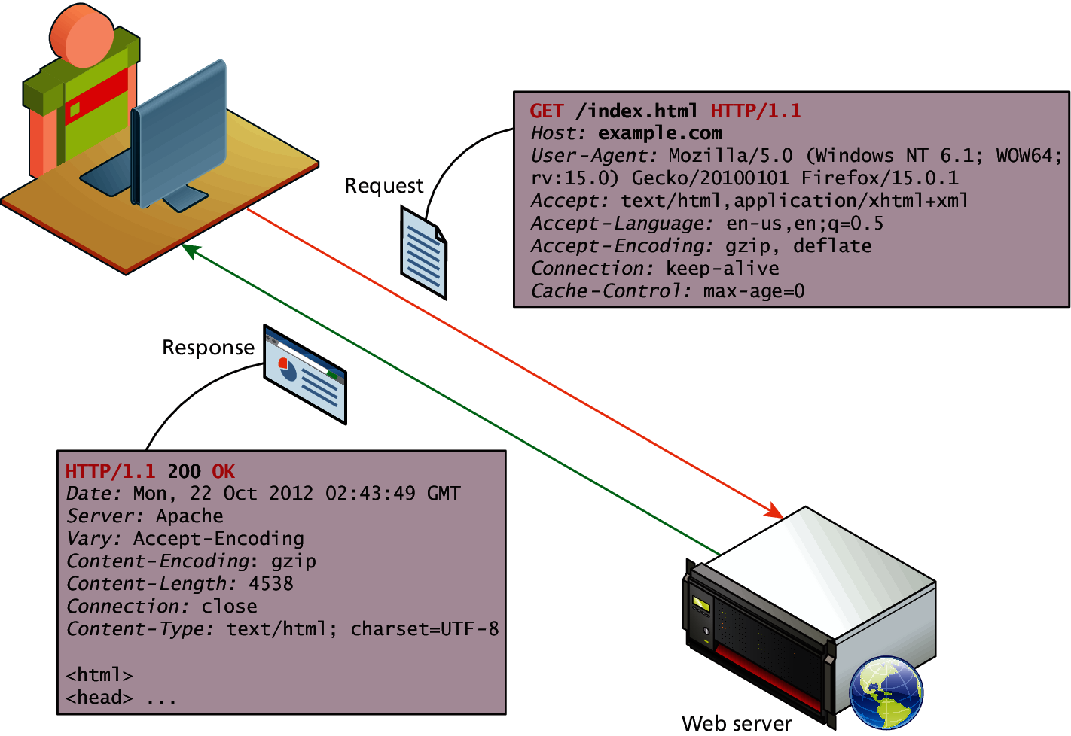
HTTP
The HTTP protocol establishes a TCP connection on port 80 (by default).
The server waits for the request, and then responds with a response code, headers and an optional message (which can include files).

Slide 59
Web Requests
While we as web users might be tempted to think of an entire page being returned in a single HTTP response, this is not in fact what happens.
In reality the experience of seeing a single web page is facilitated by the client's browser which:
requests the initial HTML page,
then parses the returned HTML to find all the resources referenced from within it like images, style sheets and scripts.
Only when all the files have been retrieved is the page fully loaded for the user

Slide 60
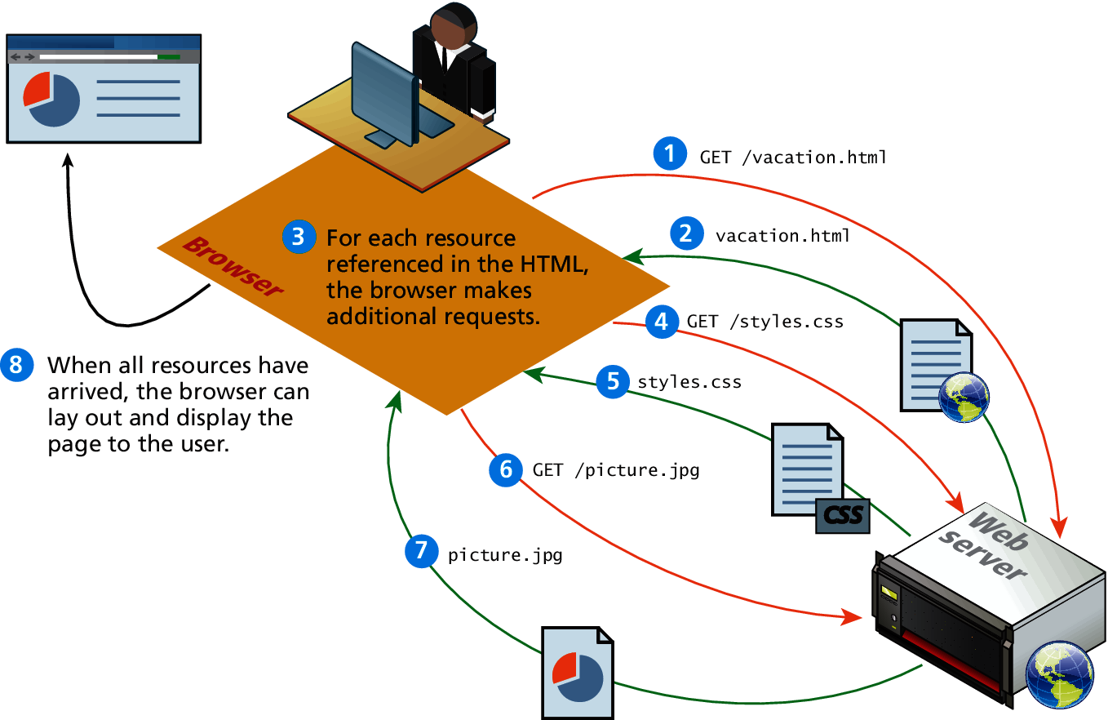
Browser parsing HTML and making subsequent requests

Slide 61
Browser Tools for HTTP
Modern browsers provide the developer with tools that can help us understand the HTTP traffic for a given page.

Slide 62
HTTP Request Methods
The HTTP protocol defines several different types of requests, each with a different intent and characteristics.
The most common requests are the GET and POST request.
Other requests include: PUT, DELETE, CONNECT, TRACE and OPTIONS.

Slide 63
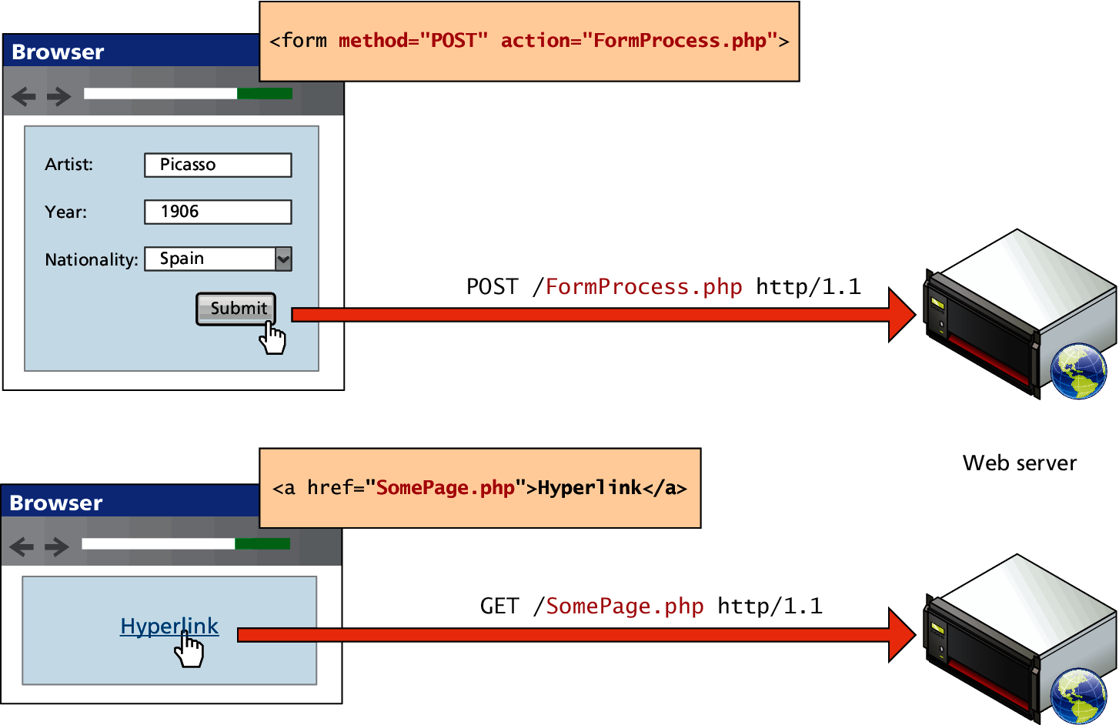
GET versus POST requests

Slide 64
Web Servers
A web server is, at a fundamental level, nothing more than a computer that responds to HTTP requests.
Regardless of the physical characteristics of the server, one must choose an application stack to run a website.
This stack will include an operating system, web server software, a database and a scripting language to process dynamic requests.

